Slide 1
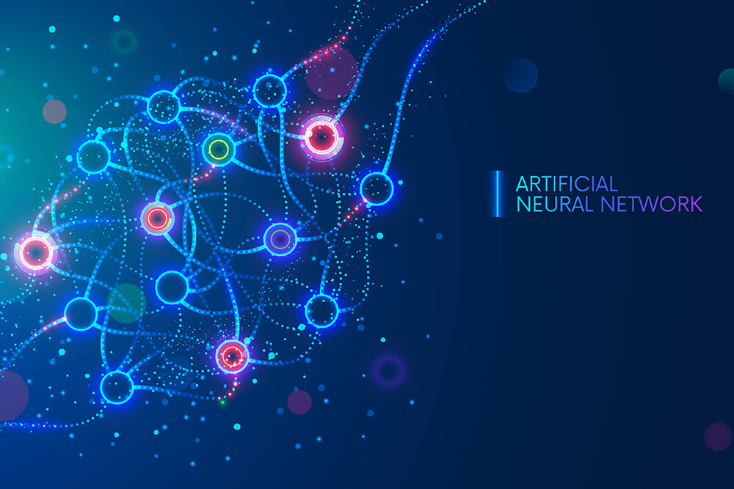

ANALISI DI MERCATO 2022-2023
SIAFA 28/04/2023
Serena Alderisi
M.Sc. Data Scientist

Slide 2
Table of Contents
Real World Applications
01
Intro
02
03
ANN types
04
Class Material
Course Introduction
Computer Vision, Healthcare, Covid-19 and other applications
Basic structure and different ANN types
Reccommended readings and external tools

Slide 3
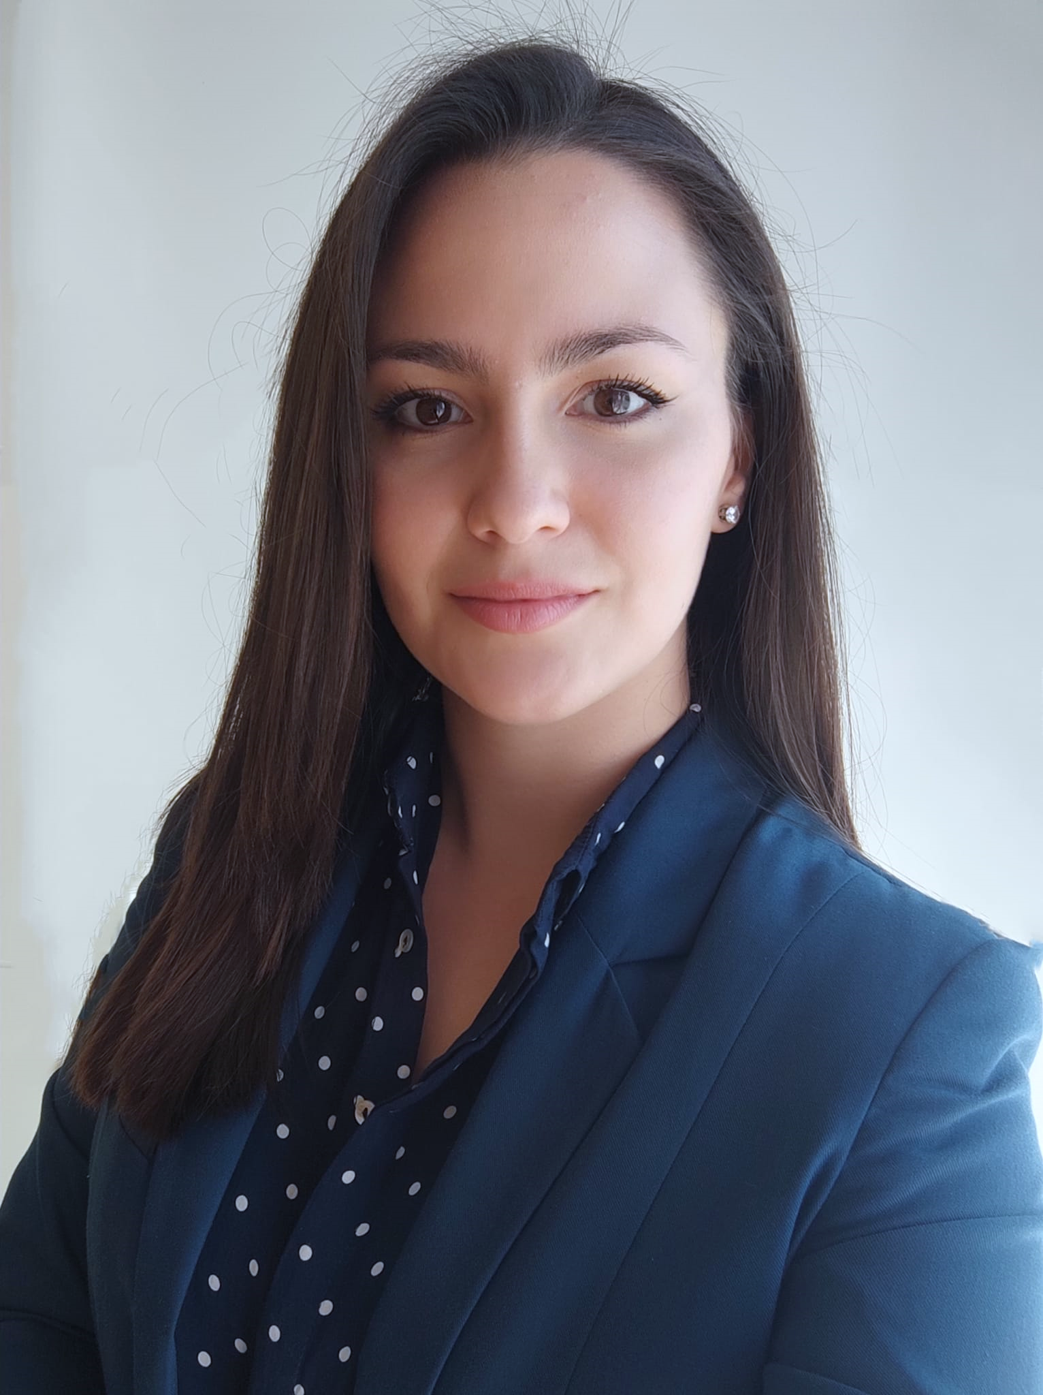


What about me?
Serena Alderisi (she/her)
Data Scientist and Machine Learning Expert at Siemens
Equity Ambassador and Data Science Tutor
Data Science Speaker
Masters of Sciences in Data Science
Universidad Politécnica de Madrid
Bachelor Degree in “Statistica e Informatica per la gestione
delle imprese” Universita degli studi di Napoli Parthenope
serena.alderisi@gmail.com
Serena Alderisi

Slide 4
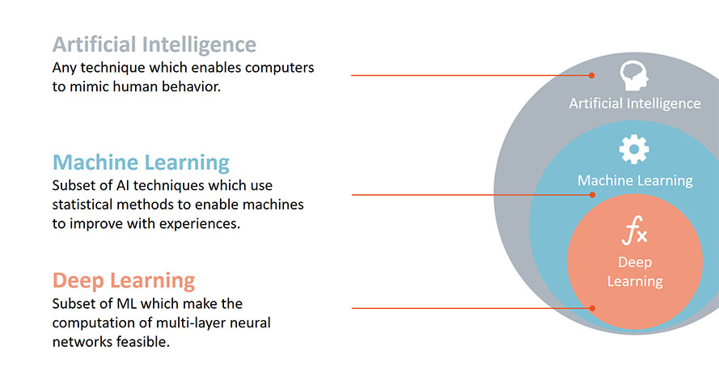
AI world contest

Slide 5
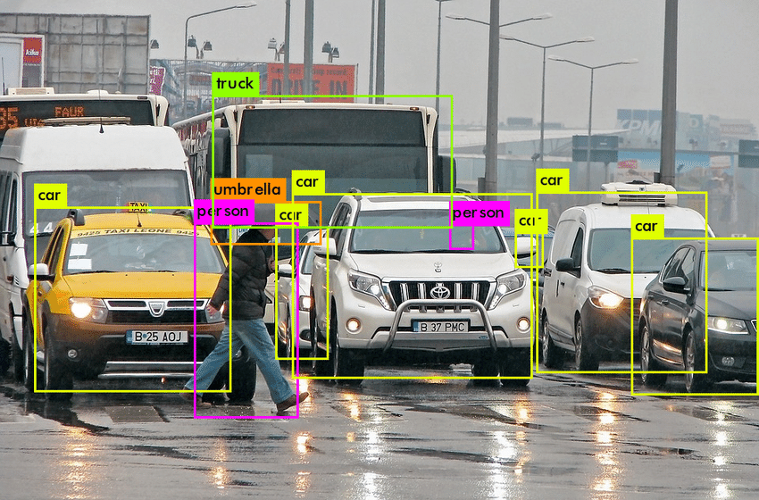

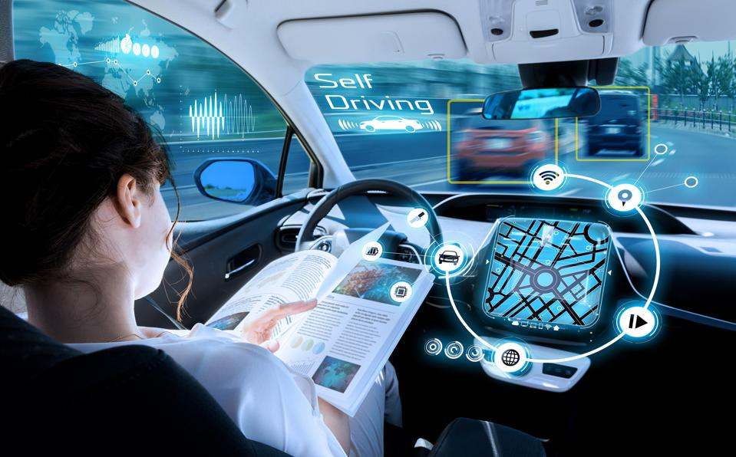
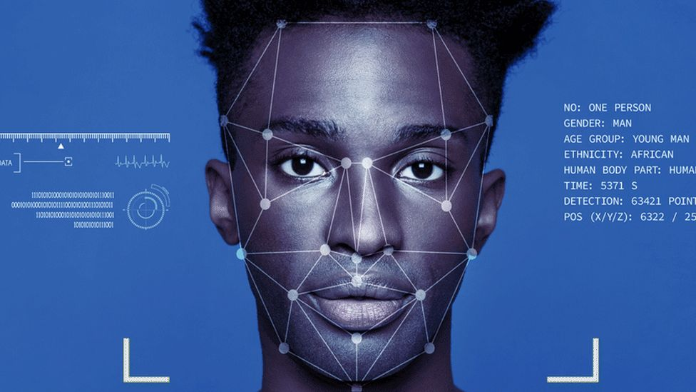
Computer Vision

Slide 6
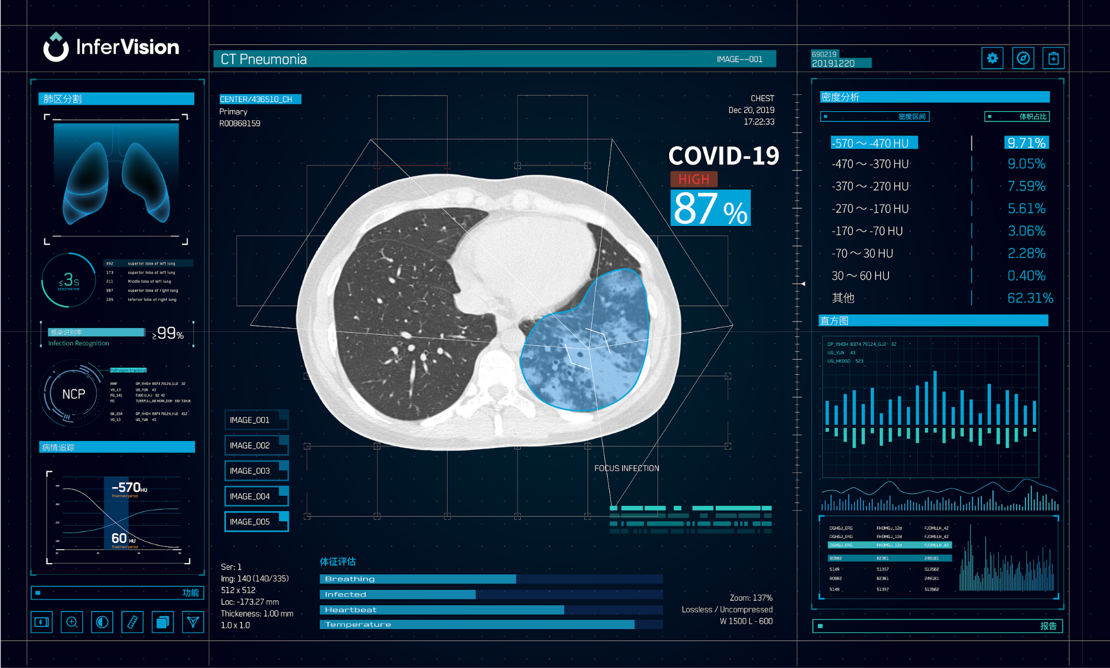
Healthcare

Slide 7
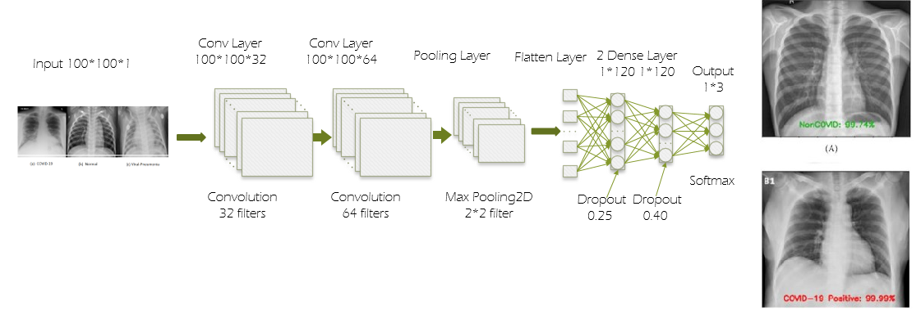
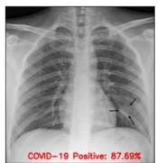
COVID-19
Earlier Diagnosis
More Accurate Diagnosis
Better ICU management
Resources Saving
Lifes Saving

Slide 8



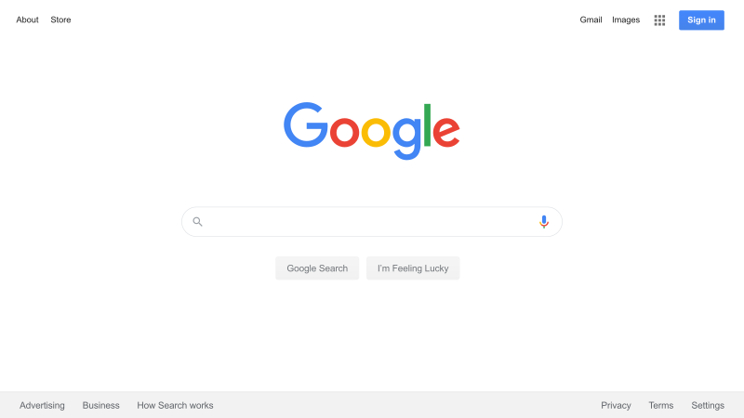
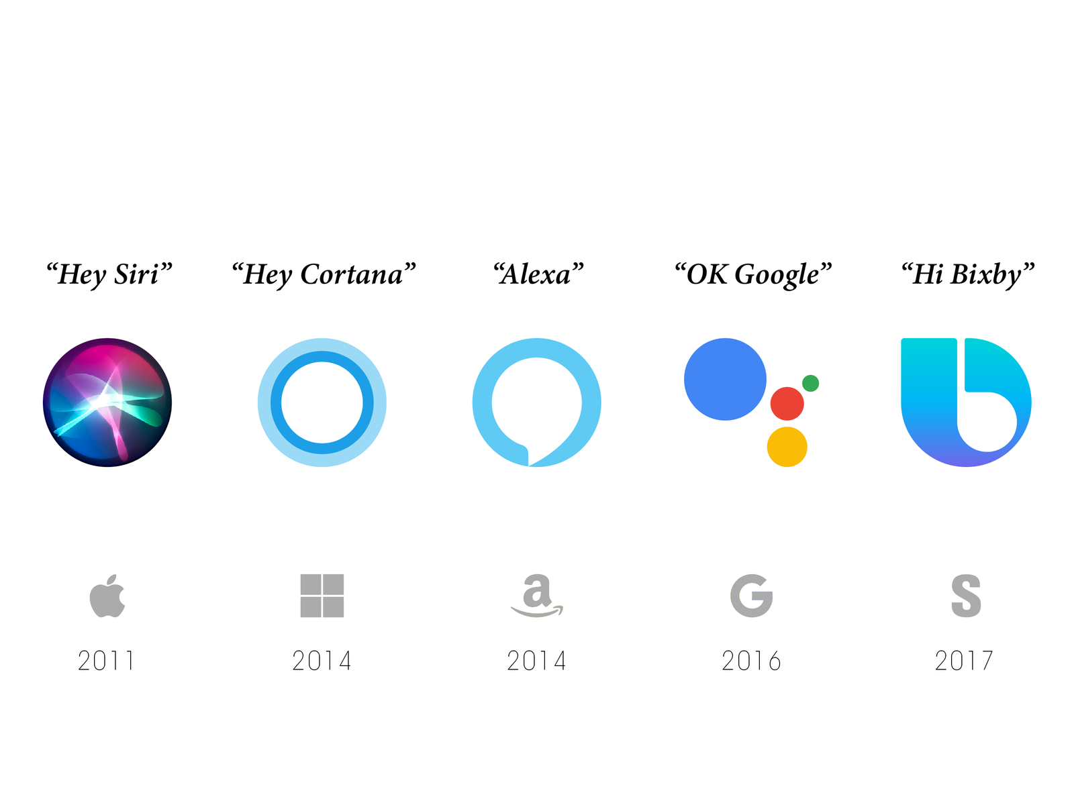

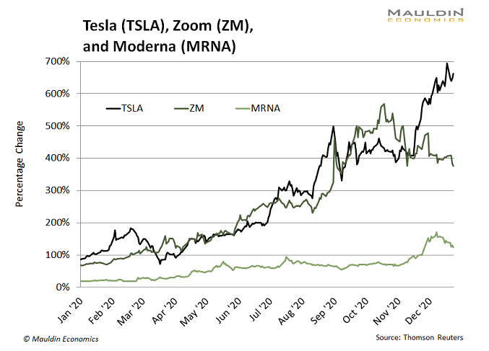
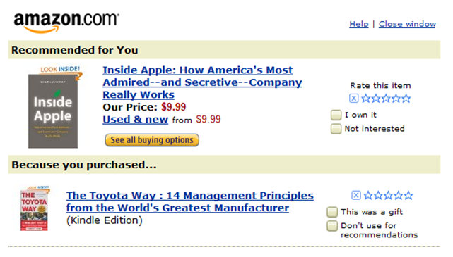

Other Applications

Slide 10
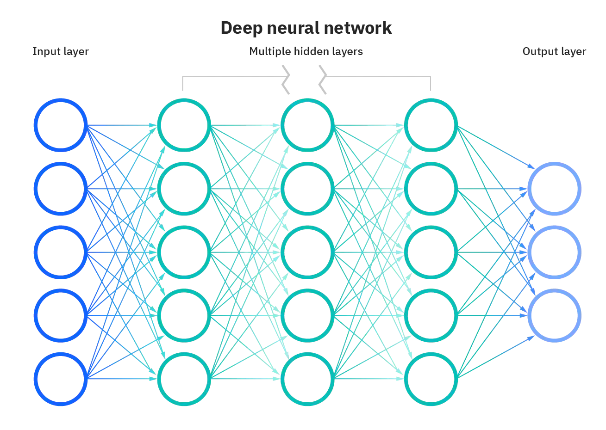

Slide 11
Reccomended Readings
Machine Learning vs Deep Learning
Make your own instagram fiter with-facial recognition
Machine Learning applied to Covid 19 research paper
Infervision AI tool by Alibaba
Deep Learning applications
Neural Networks Applications
Fraud detection with machine learning 5 uses cases

Slide 12


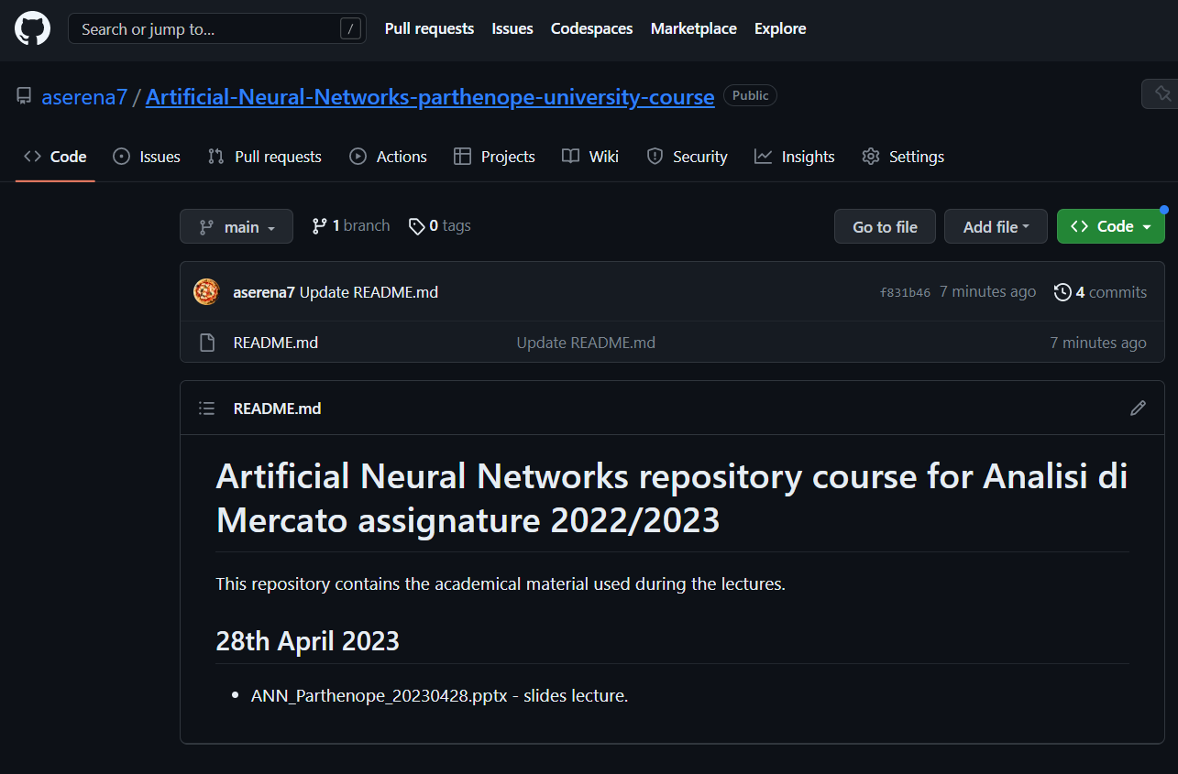
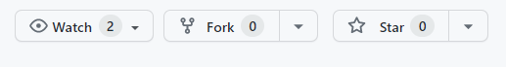
Course material

Slide 13
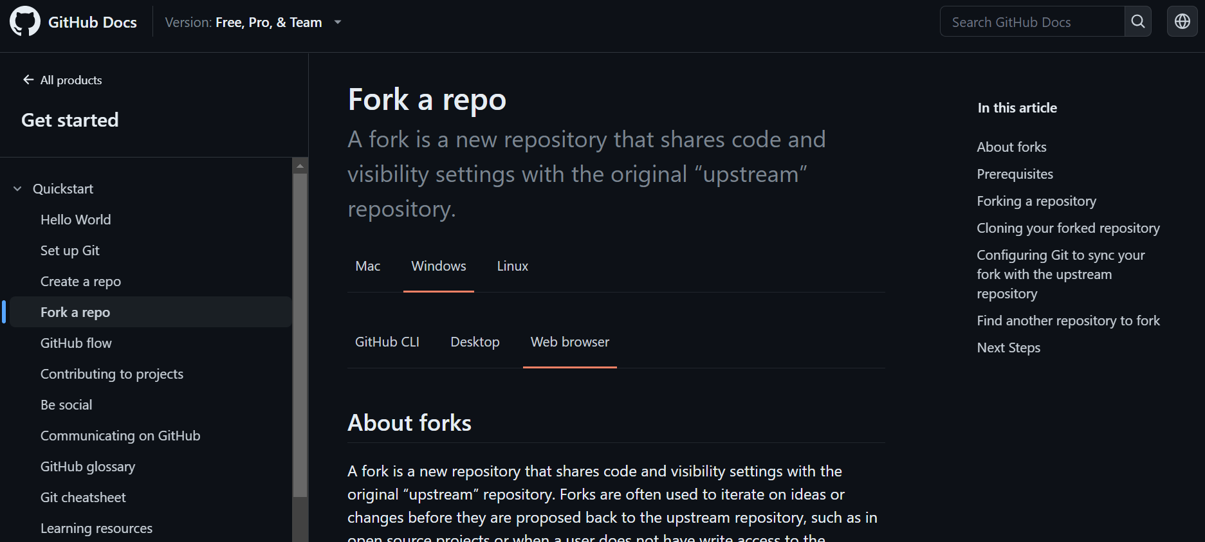
GitHub documentation

Slide 15
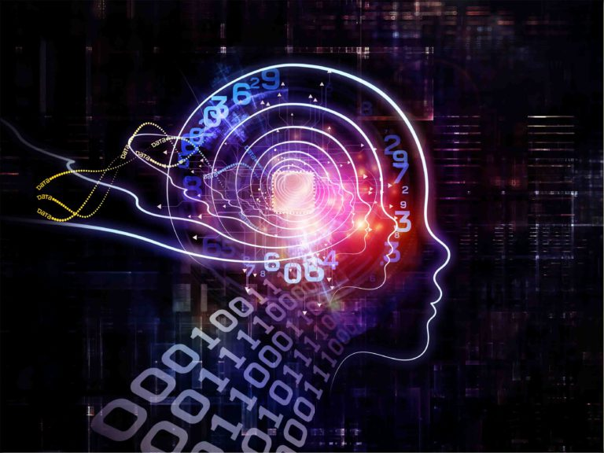
Artificial Neural Network

